Slide 1
CRIMINAL MANAGEMENT SYSTEM

Slide 2
TABLE NAME : POLICE
FIELD | DATA TYPE | SIZE | CONSTRAINT
Police id | Int | 10 | Primary key
Police name | Varchar | 20 | Not null
Department | Varchar | 20 | Not null
Degree | Varchar | 20 | Not null
Username | Varchar | 20 | Not null
password | Varchar | 20 | Not null

Slide 3
TABLE NAME: CRIMINAL
FIELD | DATA TYPE | SIZE | CONSTRAINT
First name | Int | 10 | Primary key
Lastname | Varchar | 30 | Not null
Aadhar number | Varchar | 30 | Not null
Mobile | Int | 10 | Not null
Age | Int | 5 | Not null
Gender | Varchar | 10 | Not null
address | Varchar | 30 | Not null

Slide 4
TABLE NAME: CASE
FIELD | DATA TYPE | SIZE | CONSTRAINT
Case id | Int | 10 | Primary key
Case name | Varchar | 20 | Not null
Case number | Int | 20 | Not null

Slide 5
TABLE NAME: HISTORY
FIELD | DATA TYPE | SIZE | CONSTRAINT
History id | Int | 10 | Primary key
Aadhar number | int | 20 | Not null
First name | Varchar | 30 | Not null
Last name | Varchar | 20 | Not null
Mobile | Int | 10 | Not null
Age | Int | 10 | Not null
Gender | Varchar | 5 | Not null
Address | Varchar | 30 | Not null
Case name | Varchar | 20 | Not null
description | Varchar | 30 | Not null

Slide 6


Slide 7
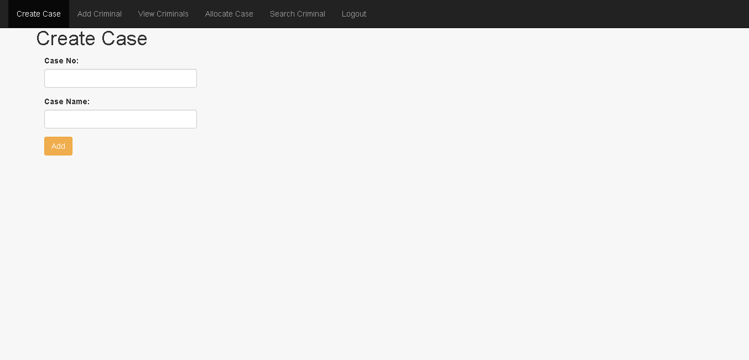

Slide 8
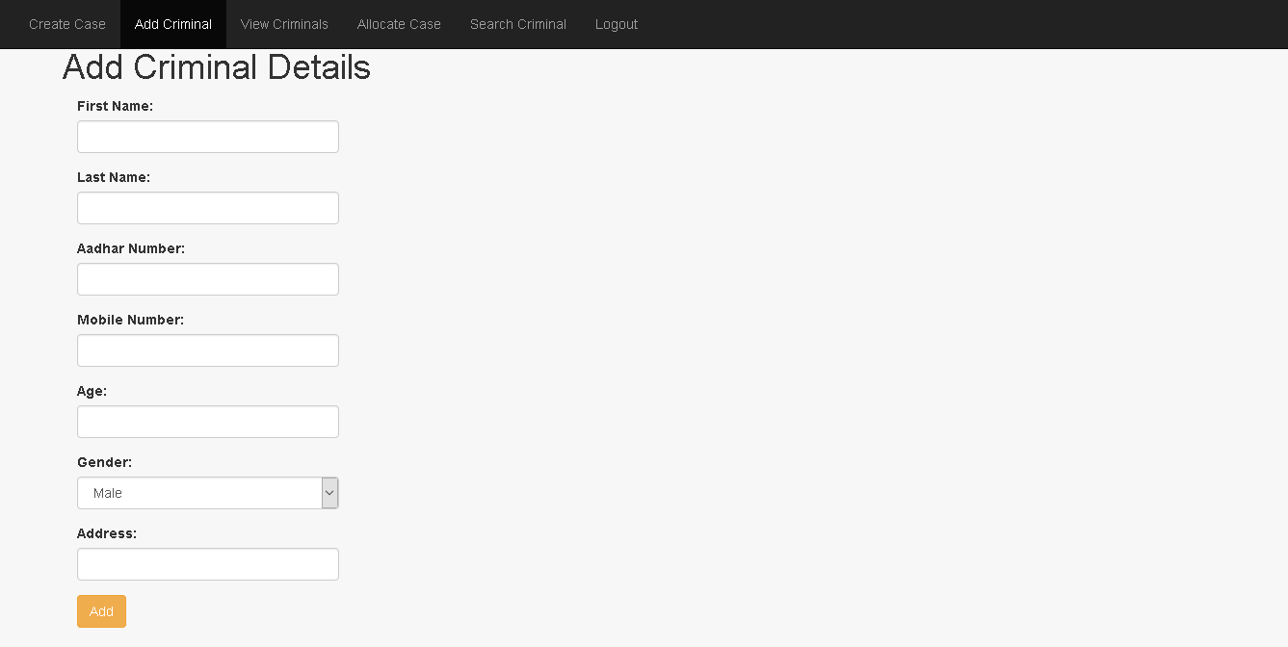

Slide 9
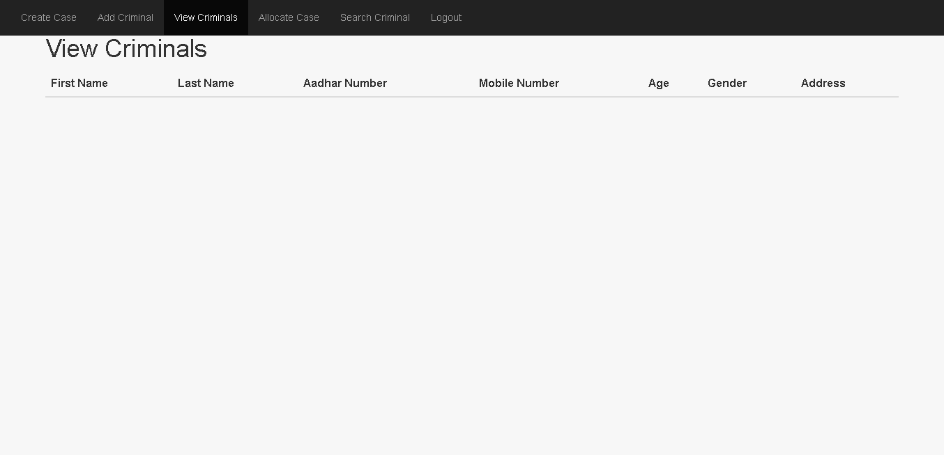

Slide 10
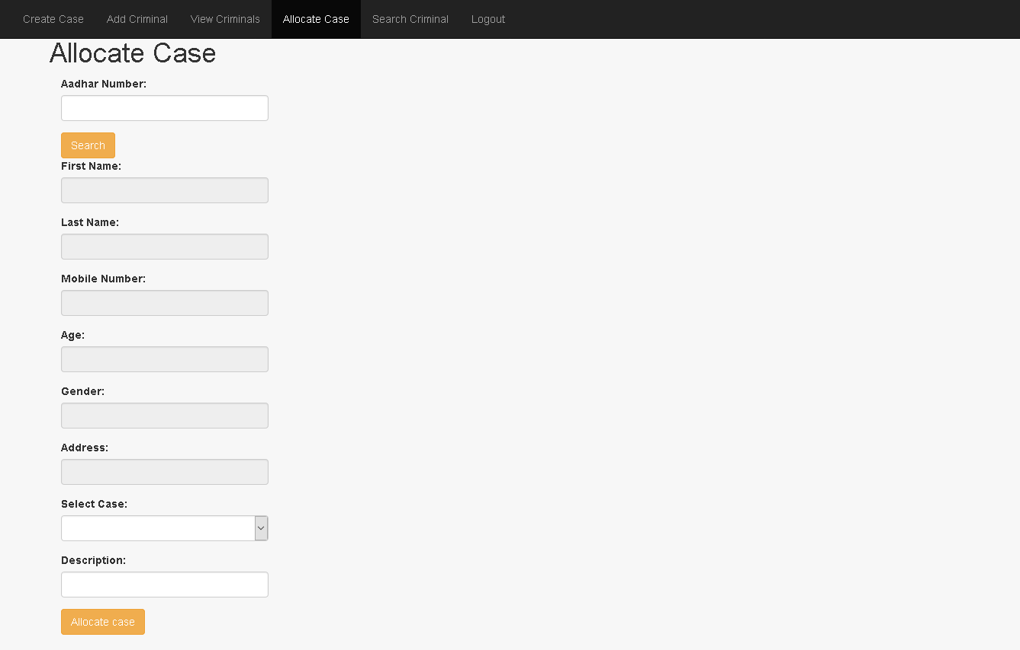

Slide 11
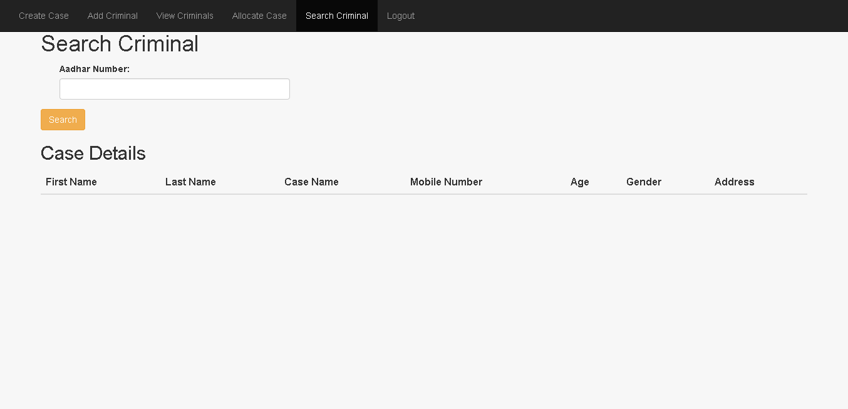

Slide 12
Thank You

